Slide 1
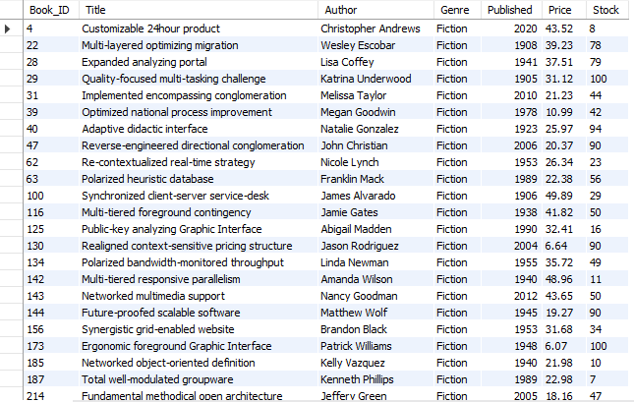
Retrieve all books in the "Fiction" genre
SELECT * FROM Books
WHERE Genre = "Fiction";

Slide 2
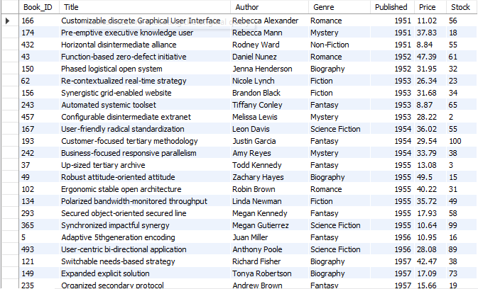
Find books published after the year 1950
SELECT * FROM Books
WHERE Published > 1950
ORDER BY Published
ASC;

Slide 3

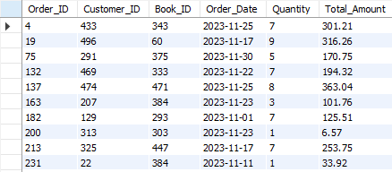
List all customers from the Canada
SELECT * FROM Books
WHERE Genre = "Fiction";
Show orders placed in November 2023
SELECT * FROM Orders WHERE Order_Date
BETWEEN '2023-11-01' AND '2023-11-30';

Slide 4

Retrieve the total stock of books available
SELECT SUM(Stock)
AS Total_Stocks
FROM Books;
Find the details of the most expensive book
SELECT * FROM Books
ORDER BY Price DESC
LIMIT 1;

Slide 5
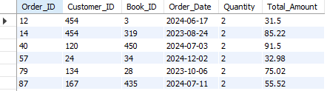
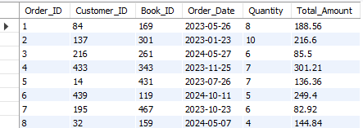
Show all customers who ordered more than 1 quantity of a book
SELECT * FROM Orders
WHERE Quantity >1
ORDER BY Quantity ;
Retrieve all orders where the total amount exceeds $20
SELECT * FROM Orders
WHERE Total_Amount > 20

Slide 6
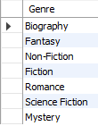
List all genres available in the Books table
SELECT Genre
FROM Books
GROUP BY Genre;
Find the book with the lowest stock
SELECT * FROM Books
ORDER BY Stock
LIMIT 1;

Slide 7

Calculate the total revenue generated from all orders
SELECT ROUND(SUM(Total_Amount))
AS Total_Revenue_Generated
FROM Orders;

Slide 8
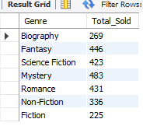
Retrieve the total number of books sold for each genre.
SELECT Genre, SUM(Quantity) AS Total_Sold
FROM Orders o
JOIN Books b ON o.Book_ID = b.Book_IDGROUP
BY Genre;

Slide 9
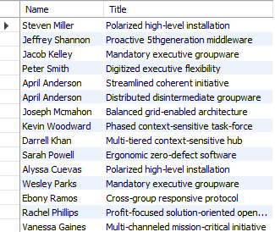
List each customer’s full name and the titles of books they’ve purchased
SELECT c.Name, b.Title
FROM Orders o
JOIN Customers c
ON o.Customer_ID = c.Customer_ID
JOIN Books b
ON o.Book_ID = b.Book_ID;

Slide 10
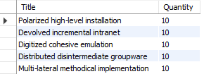
Show the top 5 most sold books based on total quantity ordered
SELECT Title, Quantity
FROM Books b
JOIN Orders o
ON b.Book_ID = o.Book_ID
ORDER
BY Quantity DESCLIMIT 5;

Slide 11
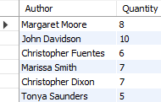
Display each author's name along with the total number of their books sold.
SELECT Author, Quantity
FROM Books b
JOIN Orders o ON b.Book_ID = o.Book_ID;

Slide 12
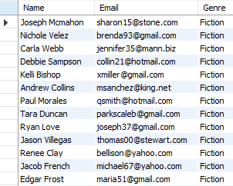
Get the names and emails of customers who have purchased books from the "Fiction" genre.
SELECT Name , Email , Genre
FROM Customers c
JOIN Orders o
ON c.Customer_ID = o.Customer_ID
JOIN Books b
ON o.Book_ID = b.Book_ID
WHERE Genre = "Fiction";

Slide 13
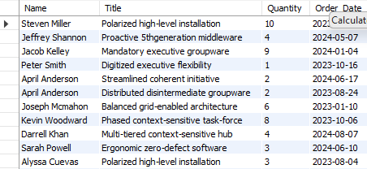
Show detailed order information including customer name, book title, quantity, and order date.
SELECT c.Name , b.Title , o.Quantity , o.Order_Date
FROM Customers c
JOIN Orders o
ON c.Customer_ID = o.Customer_ID
JOIN Books b ON o.Book_ID = b.Book_ID;

Slide 14
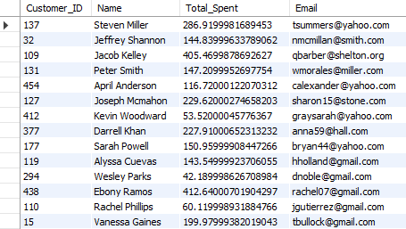
Calculate the total amount each customer has spent
SELECT c.Customer_ID,c.Name , SUM(b.Price*o.Quantity)
AS Total_Spent ,c.Email
FROM Customers c
JOIN Orders o
ON c.Customer_ID = o.Customer_ID
JOIN Books b
ON o.Book_ID = b.Book_ID
GROUP BY c.Name ,c.Email ,c.Customer_ID;

Slide 15
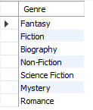
List genres that haven’t had any sales/orders yet.
SELECT DISTINCT b.Genre
FROM Books b
LEFT JOIN Orders o
ON b.Book_ID = o.Book_ID
WHERE o.Order_ID IS NULL;

